Slide 1
> glasgowrpg

Slide 2
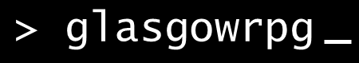
Overview
Text based role-playing game
Providing a story with multiple branches and outcomes
Based in/around student life.

Slide 3

User Personas
Age: 21
Gender: Male
Occupation: Student
Interests: Retro Games, Gardening
Location: Glasgow
Street Fighter II Turbo
Dungeon Master
Super Mario Bros. 3
Favourite Games
BIO:
Daniel Duncan is a 2nd year Computer Science student in University of Glasgow with a interest in retro games. Once a week, he would spend some time at the local arcade with his friends. Being the president of UoG retro games club, he constantly finds unique retro games to share with other members of the club.

Slide 4

User Personas
Age 23
Gender: Female
Occupation: Student
Interests: Badminton, Hiking
Location: Glasgow
Favourite Games
Super Mario Run
Words With Friends
Candy Crush Saga
BIO:
Gemma Brett is a 4th year dentistry student in the University of Glasgow. She either reads or play mobile games to make her daily commute less boring. She wouldn’t hesitate to buy a game if its interesting and highly rated.

Slide 5
Specification
Short story with multiple branches/outcomes
Tracked user state.
User accounts.
State stored with accounts.
Able to resume game.
Track/show decisions made by userbase.

Slide 6

System Architecture
Client
Middleware
Database
User
No External Services.

Slide 7
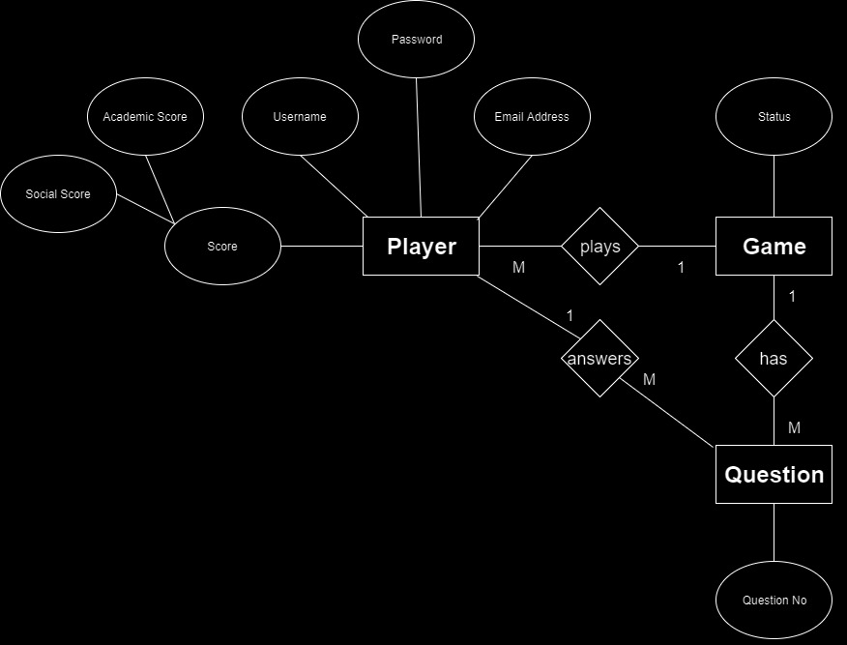
ER Diagram
Field | Type
Social score | Integer
Academic Score | Integer
Username | Char (20)
Password | Char (128), password format
Email Address | Char (50)
Status | Integer
Question No. | Integer

Slide 8
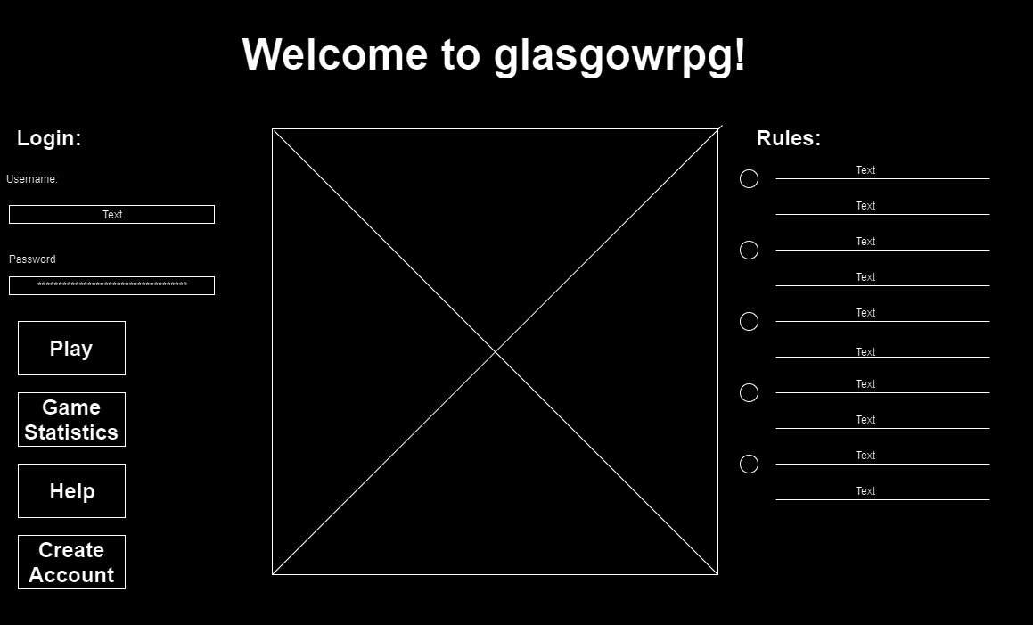
Wireframe: Home

Slide 9
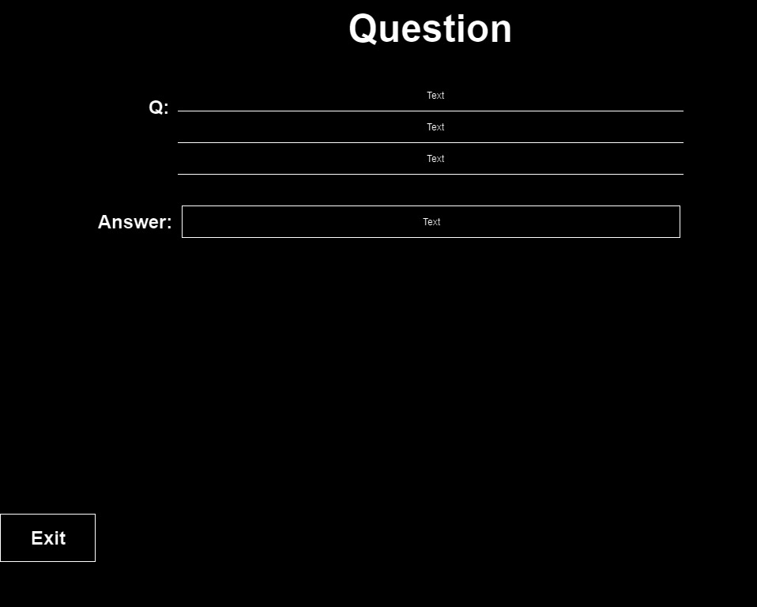
Wireframe: Play

Slide 10
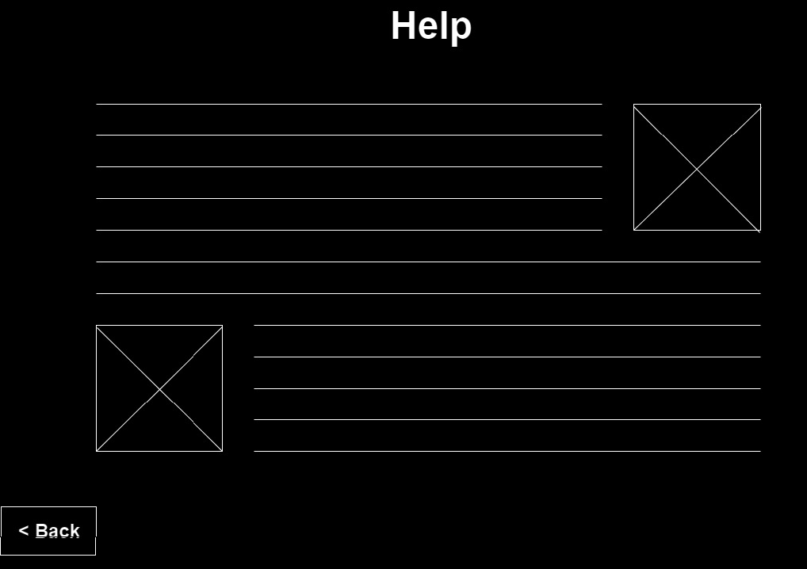
Wireframe: Help

Slide 11
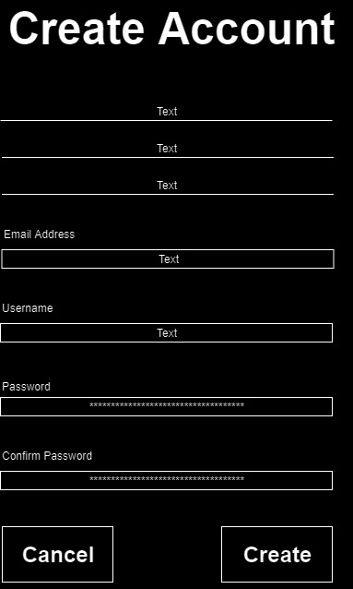
Wireframe: Create Account

Slide 12
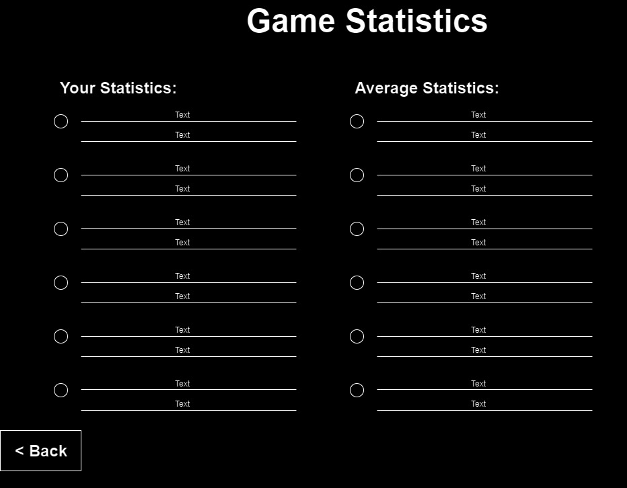
Wireframe: Stats

Slide 13
Walkthrough:
Site Map
Home Page(index)
Play
Help
Stats (hivemind)
Create Account
myAccount

Slide 14
Site URLs
/home
/play
/help
/stats
/createAccount
/myAccount

